Slide 1
Research Project on the Design of the Structure of Technology Universities (DSTU)
Gujarat Technological University, Ahmedabad
Saturday, 18th May 2013
Presentation by
Akshai Aggarwal
e-mail: vc@gtu.ac.in
Gujarat Technological University

Slide 2
Vision
Vision: to make GTU a hub of research, technology and entrepreneurship
Gujarat is Number #1in growth rate. It has become well-known for excellent governance.
Need to develop new innovative and revolutionary way to emulate similar success in education to make GTU world class university
GTU to be a Leader in Learning Outcomes through use of technology, Faculty Development Programs and through a collaborative model

Slide 3
Definition: A World-class University
Attracting scholars who are global leaders in their fields.
Internationalization of faculty and students
Leader in academic research and teaching
Creating an eco system for innovation - leveraging academic and industrial research
Fostering entrepreneurship through management education
One-stop hub for continuing learning programs through regular as well as distance education
Reference: Center for World-Class Universities ( CWCU ) at Shanghai Jiao Tong University's (SJTU) -a strategic research unit of the Chinese Ministry of Education (http://gse.sjtu.edu.cn/EN/centers.htm)

Slide 4
SJTU: From QS rank 179 (2006) to 125 (2012) From ARWU rank 450 (2003) to 151-200(2012)!
Characteristics of a world-class university:
a high concentration of talent,
abundance of resources and autonomy in academic investment
autonomous governance in recruitment of students and faculty, in learning systems and in assessment systems
carries out education and research in a wide range of disciplines and
makes great efforts to serve both national needs and international public good
Reference: Qi Wang, “Internationalisation of Higher Education and Building World-class universities in Mainland China: a Case of Shanghai Jiao Tong University”, www.aie.org.cn/link/Strand%203/Wang%20Qi%20(Whole%20Paper).docx as of June 30, 2010
Notes:
Donations: Ratan tata: harvard Business School: $50m; Anand Mahindra: Harvard Humanities Center: $ 10 M; Narayan Murthy: $5 M; Narayan Murthy: IIT: $8m; Vinod Khosla (IITD: $5M; AviNash: IITB:1M; Arun shourie: IITK: Rs 11 crore; Sunil Mittal for education of poor children: Rs 200 crores; Azam premji Foundation for its Univ and schools: Rs 8,846 crores

Slide 5
An American Perspective Reference: ‘Why is Harvard #1?’ by Shailendra Raj Mehta, an IIMA White paper dt 5th April 2012
Universities are more competitive and autonomous if they: to quote (Aghion, Dewatripont et al. 2010) page 20:
1. “do not need to seek government approval of their budget,
2.select their baccalaureate students in a manner independent of the government,
3.pay faculty flexibly rather than based on a centralized seniority/rank‐based scale,
4. control their hiring internally,
5. have low endogamy,
6. own their own buildings,
7. set their own curriculum,
8.have a relatively low %age of their budget form core government funds
9.have a relatively high percentage of their budget from competitive research grants.”

Slide 6
Dr Renu Khator’s Mantra (President Houston University, Texas, USA)
Promise Less, perform More; Collaborative Efforts for excellence
Don’t accept mediocrity, whatever be the constraints
Establish your own significance in your mind
Effective collaborations with society and industries
Introspection and readiness for change; identify and work with agents of change

Slide 7
Formula: How to remain poor?
50% or more: graduate with a load of ATKTs all through the studies at a University

Slide 8
GTU:
a hub of research, technology and entrepreneurship
a Leader in Learning Outcomes
Is this vision required for a University in Gujarat/ India?
Can this vision be realized?

Slide 9
Realizing the vision: A Challenge, we have unfortunately refused to meet for decades
“If India cannot improve the quality of the mainstream universities and the ….. colleges affiliated to them, the overall quality of the system cannot rise. This has been the key challenge for decades -- and it remains the key factor”
--- Philip G. Altbach
“India’s Higher Education Quality Deficit”
The World View
Inside Higher Education, dated Aug 20, 2010
http://www.insidehighered.com/blogs/the_world_view/india_s_higher_education_quality_deficit

Slide 10
Constraining an institution → stunted growth
"The HRD Ministry had stipulated that the director needed permission from the ministry every time he had to travel abroad. The permission was not easy to get and invariably came at the last minute. The directors of the IIMs were restrained from travelling abroad by this rule for over three decades. As a result, the country has been the biggest loser.“
-N.R.Narayana Murthy
in the book, 'Nurturing Institutional Excellence: Indian Institute of Management, Ahmedabad' by IIM-A alumni dean Vijaya Sherry Chand and visiting faculty T V Rao

Slide 11
Failure to realize the vision: Are we worried?
“I’m terribly worried about education in India. …….there is a significant opportunity for India to continue to grow at 9-10 per cent. But what will hold us back is education and lack of manpower.”
---- Mr. S. Gopalakrishnan,
CEO, Infosys Ltd,
in NDTV’s ‘Walk the Talk’ interview
The Indian Express, Ahmedabad, dt. 10th August, 2010
Note: Mr. Gopalkrishnan was talking about shortage of ‘employable’ young persons, with quality education.

Slide 12
World ‘s Rankings!

Slide 13
A Report on Research Output of China and India by Thomson Reuters
S.No. | Area of Research | Share of world research output in %age in 2010
 |  | India | China
1 | Mathematics | 2 | 17
2 | Materials Sciences | 6.4 | 26
3 | Physics | 4.6 | 19
4 | Computer | 2.4 | 15 (Korea 6.3% and Taiwan 5.7%.)
Reference: http://www.indiaeducationreview.com/news/indias-global-research-output-just-35-study
Extract from the Report: "During the 1980s and 90s, the output of India's research was almost static while other countries grew rapidly, particularly in Asia. China expanded with an intensity and drive that led it rapidly to overtake leading European countries in the volume of its research publications.”

Slide 14
The Afro-Asian Perspective of 2011: Does India have world-class Universities?
India’s Best by QS Ranking
2011 : China has 5 Universities among the first 50 (and 7 more before 218).
2011: Ahead of India in 2011: Thailand (2011: Chulalongkorn University at rank 171), Malayasia (2011: Universiti Malaya (UM) at rank 167), Saudi Arabia (2011: King Saud University at rank 200), Indonesia (2011: University of Indonesia at rank 217)
Year | 2009 | 2010 | 2011 | 2012
IITB | 163 | 187 | 225 | 227
IITD | 181 | 202 | 218 | 212

Slide 15
QS Rankings of 2012
China continues to surge ahead.
The Rankings of the best Universities of Japan, Taiwan, South Korea and Singapore continue to be ahead of that of the best University of India.
Ahead of India in 2012: The Ranking of the best Universities of Thailand (Chulalongkorn University: 201), Malaysia (Universiti Malaya (UM): 156)and Saudi Arabia (King Saud University at rank 197)
Indonesia: Univ of Indonesia ranking fell from a rank of 217 in 2011 to a rank of 273 in 2012 – still ahead of 3 of the 5 old IITs
IIT-Kanpur (2012: 278; 2011: 306; 2010: 249; 2009: 237)
IIT- Kharagpur (2012: 349; 2011: 341; 2010: 311; 2009: 335)
IIT-Madras (2012: 312; 2011: 281; 2010: 262; 2009: 284)
Notes:
2012: University of Indonesia has fallen to rank 273 (In 2011, its rank was 217.)

Slide 16
“Times Higher Education“, London The First Asian Universities Ranking 2013
1. Japan: University of Tokyo 78.3/100
2. Singapore: National University of Singapore 77.5/100
3. China: University of Hong Kong 75.6/100
4. China: Peking University 70.7/100
Notes: Japan: 22 Universities among the top 100; Taiwan: 17 Universities among the top 100; China: 15 Universities among the top 100; South Korea: 14 Universities among the top 100; Turkey: 5 Universities among the top 100; Israel: 4 Universities among the top 100; Iran and India: 3 Universities each among the top 100.
India: only three IITs- no conventional university; IITs Grade (i) well on industry income & innovation (ii) moderate in teaching & research.
IIT, Kharagpur (Rank: 30- 41.6/100); IIT, Bombay (Rank: 33- 40.6/100); IIT, Roorkee (Rank: 56- 29.9/100).

Slide 17
QS World University Rankings by Subject 2012 - Computer Science And Information Systems
First 10: not one from inDIA
First 50: not one from inDIA; cHINA has 5 at RANKS 13, 22, 35, 35, 42
From 50 onwards: for ranking by subject, exact rank is not given: QS only specifies whether the University lies in the range of 51-100 or in the range of 101-150
For rank 51-150, CHINA has 7 Universities, INDIA has 6:
In the range of Ranks 51—100: iitb, iitd and iitk appear
In the range of Ranks 101—150: iiSc, iitKGP and iitM appear.
Reference: http://www.topuniversities.com/university-rankings/university-subject-rankings/2012/computer-science-and-information-systems

Slide 18
Research & Innovation in BRIC Reference:https://exmail.net4india.com/owa/?ae=Item&a=Open&t=IPM.Note&id=RgAAAAAapA4zlGn%2bRbPSW6SRgCA5BwDvvWUb6ON1ToqzUzWTMJnRAAAFrnDmAAD54x0TKJxhQa%2bAhS3Sx3IYAAAArDgKAAAA&pspid=_1363276720255_9864517

Slide 19
Top Engineering and Technology Universities in the World, April 2011
Among the first 10: 7 from USA, 1 from Switzerland and 2 from UK – none from Asia
Among the first 50: Asia has 10:
1 from Singapore,
2 from HongKong,
4 from China,
1 from Japan,
1 from Korea,
1 from Taiwan,
none from India
Reference: http://scholarship-positions.com/blog/top-engineering-and-technology-universities-in-the-world/201108/

Slide 20
The poor state of technical education in India
"In a surprise inspection conducted by AICTE in 400 colleges, as many as 350 were found not fulfilling basic norms stipulated by the council.” –M K Hada, AICTE Advisor,
-as reported on 22nd Nov 2012 in
“90% technical schools in India flouting norms: AICTE officials” – Times of India
Reference: http://timesofindia.indiatimes.com/home/education/news/90-technical-schools-in-India-flouting-norms-AICTE-officials/articleshow/17315671.cms as of 22nd Nov 2012
UGC List of Universities (9) and Colleges with Potential for Excellence: ---Not one technology institution

Slide 21
Can/ Should
India/ Gujarat have a world-class University?

Slide 22
Can we have an excellent University in 10 years?
Rockefeller asked Charles W. Eliot, the President of Harvard University,
” What would it take to create another Harvard?”
Eliot retorted that it would take $50 Million and 200 years.
But in a matter of decades, Chicago, Stanford, Johns Hopkins, Carnegie Mellon and Duke became Ivy League Universities.
made possible by a control and contribution by alumni, a visionary leadership and a munificent donor at the beginning. Reference: ‘Why is Harvard #1?’ by Shailendra Raj Mehta, an IIMA White paper dt 5th April 2012
1985 : China and India were at the same (poor) level ; In 25 years, China’s best has raced ahead of the best of Japan.

Slide 23
Is this vision required for a University in Gujarat?
A matter of opinion
I feel it is, since those without knowledge will be as helpless in the twenty-first century as those without arms were from 12th to 20th century.
Some others may feel that China may lead us by miles in technology and production skills. But our trading skills will be able to help us hold our own.

Slide 24
Can this vision be realized?
In 1985 Indian and Chinese Universities were nearly at the same low level.
China coined the word ‘World-class University’ and established a University Department for full-fledged study of World-class Universities at Shanghai Jiao Tong University (SJTU).

Slide 25
Easy solutions by plagiarism
1854-57: EIC established the first three Universities at Chennai, Mubai and Kalkutta by copying the then model of London University
1946-56: Sarkar Committee, established by the Viceroy’s Council, proposed setting up of institutions based on the MIT model → IITs
1965-70: Agricultural Universities based on the American Land Grant model
1980-2010: Autonomous Colleges and Deemed Universities

Slide 26
No innovative policies
No Review of policies after failure is clearly seen
Every time a yearning to establish something new, leaving aside the broken system
Sloganeering and no hard thinking, no experimentation and hard evaluation

Slide 27
SFIs: A study by Prof Prem Vrat VC, ITM University, Gurgaon and former Director, IITD
For quality, the effect of a number of factors has been studied.
A survey has shown the state of SFIs in UP.
RESULT:
A VAST CHASM BETWEEN WHAT SHOULD BE AND WHAT EXISTS
Please see the next slide

Slide 29
Building a new Technology University: GTU
GTU: A Network of Students, Researchers, Faculty members –
Working on the challenge of creating a team
At GTU: Working for Leadership in Learning Outcomes;
Research and Industrial Collaboration;
Relevant Research and Development
Systematic study and creating our ranking system.
→ Objective: Can one dare think of being among the top ___?

Slide 30
GTU: A State University which leads from the front
To be a leader in learning outcomes
To provide the best of Continuing Education through a mix of on-line, distance and on-site education
To help incubate technologists particularly in the fields of
VLSI Design
Embedded systems
Mobile Computing and Wireless Technologies
Required: -from working professionals-
pro-active contribution to education

Slide 31
GTU is creating Networks and not Legal Entities
jointly performing quality assurance in studies, teaching and research: The challenge is to quantify for comparison, something that constantly changes operatively.
Requirements:
Develop and continuously refine assessment measures/evaluations - College Development Council
Every faculty member and researcher-- to be involved in projects in learning systems, research & consulting
- ALCE, Joint Research Projects, RCSC
Create forums for an open exchange of experiences
- Research Week, Zonal Centers & HIEQ Clubs
Notes:
High Intellectual and Emotional Quotient (HIEQ)

Slide 32
Networking of Colleges…1 Jointly improving the quality of Learning Processes
ALCE (Active Learning and Creating Excitement in classes, laboratories and workshops)
Phase 1 courses:
ALVCOM (Active Learning Video lecture Communication) – a telecast program started with technical support from BISAG
Preparing Courseware through joint efforts (Design Your Courseware competition for students)
Diploma Engineering | Degree Engineering
Communication Skills | Computer Programming and Utilization
Engineering Drawing | Calculus
Engineering Mechanics | Mechanics Of Solids
Mathematics | Engineering Graphics

Slide 33
Networking of Colleges…2 Doing Joint Research
GTU’s joint research project on Kotler’s Incubator on Ayurvedic medicines:
involves 45 faculty members and students at GTU from 45 Colleges
mentored by the Kellogg Business School.
16th August 2012 : GTU has joined on two research projects, for which the Chief Investigators are Professors Dr. Friedrich Augenstein and Dr. Ramesh Shah from DHBW. The two projects-
developed in Germany
But of equal interest to India.
28th and 29th November 2012: Workshops for researchers from GTU to start working on the projects
GTU’s Joint Analytical Lab for Pharmaceutical Sciences
url: http://www.gtu.ac.in/circulars/12NOV/22112012_03.pdf

Slide 34
Networking of Colleges…2 Promoting Joint Research
GTU BOARD for MOBILE COMPUTING and WIRELESS TECHNOLOGIES: issued a
Request For Collaborative Research Proposals (RCRP)
in the area of
Mobile Computing, Networking and Applications (MNA).
url: http://gtu.ac.in/circulars/11DEC/MNA_RCRP.pdf
GTU asked for proposals which provided
A summary of the research proposal, with Technical Description with the expected challenges and other details in 4 pages along with
The Collaboration Plan within the Team, drawn from at least three Colleges
The outreach plans with government laboratories or large industries, having interests in the field
The Plans to be relevant to Businesses and Industries (BIs) and other entities of the Society.

Slide 35
Need
Inbuilt structures which promote networking
Matrix structures, which permit joint/ multiple ways of working as needed
Example: College Development Council may have Networking Personnel, seconded to
Research & Development,
Faculties,
Schools,
Post-graduate Centers etc

Slide 36
Regulations for Affiliated Colleges
Service conditions for the teaching and non-teaching staff: to be enforced by University
Performance-based increments and other incentives/ dis-incentives: To be permitted to Colleges with an over-arching supervision by the University for fairness and transparency
Traditionally the Universities: have rights for allocating examination and other academic duties like sending them on Local Inquiry Committees.
Additionally the Universities should acquire the rights for deputing them for FDPs and research work

Slide 37
Financial Regulations and Intoxication of power
Traditionally the Universities have charged (i) enrolment fees (ii) examination fees (iii) affiliation fee per student.
For SFIs, the Technological Universities should get about 10% of the fees charged by Colleges for creating common research facilities and for encouraging the appointment of world-class professors in Colleges
Powerful bureaucrats and rich SFI managements: Not ready to accept the traditional academic processes of a University by citing their complete control of purse strings

Slide 38
Autonomy
Autonomy can help a small institution become world-class, if it has at least a couple of world-class professors in every department.
Otherwise it would become a disciplined version of a higher secondary school, which pretends to be an institution of higher learning.
A College has multiple stake-holders: Trustees, local politicians, faculty, students and parents.
It is the University, which brings the ideas of (i) quality education and (ii) investments for research to the forefront.
Other stake-holders have priorities like (i) cost-effectiveness and profits, (ii) receipt of parchment, without any hiccups and with a first class etc.

Slide 39
Existing Autonomous Colleges/ Deemed Universities
374 Deemed Universities and Autonomous Colleges:
-- must work towards bringing world-class education to niche areas --require a scientific study
My Opinion: Today: In an attempt to become a comprehensive University:
None is even on the way to be able to compete with Universities even in Malaysia/ Thailand
None is able to attract scholars (research students or teachers) from outside India – except one, which has lower costs in India as its USP for attracting foreign students.

Slide 40
Linking industry, academia and the informal sector: Collaboration with Industries & Businesses (I&Bs)
Collaboration: A 2-way process
I&Bs: would collaborate with Harvard rather than with IIMA
would allocate R & D projects to IITs and IIMs rather than to the local University
since
The collaborations and R & D projects are PR exercises and not the ‘felt need’ for I&Bs
GTU: no Seminars; only successful implementation

Slide 41
The Secret History of GTU’s Successes
10th July 2010: Forum for Research in Technological Education
13th July 2010: MBA Directors Meeting
20th July 2010: Meeting with Trustees of Colleges
2nd August 2010: Meeting with Big Businesses and Industries and launched the project of
GTU Innovation Council.

Slide 42
GTU Innovation Council
Mission: TO BRING THE CULTURE OF
INNOVATION
TO BOTH THE INDUSTRY AND ACADEMIA
GTU Innovation Sankuls
Udisha (Universal Development of Integrated Skills through Higher Education) Innovation Clubs
Reference: http://www.dnaindia.com/india/report_gujarat-technological-university-club-udisha-will-try-to-bridge-student-industry-gap_1505891
15 Grass-root Innovators from villages of Gujarat are being invited to our classrooms to inter-act with faculty members and students

Slide 43
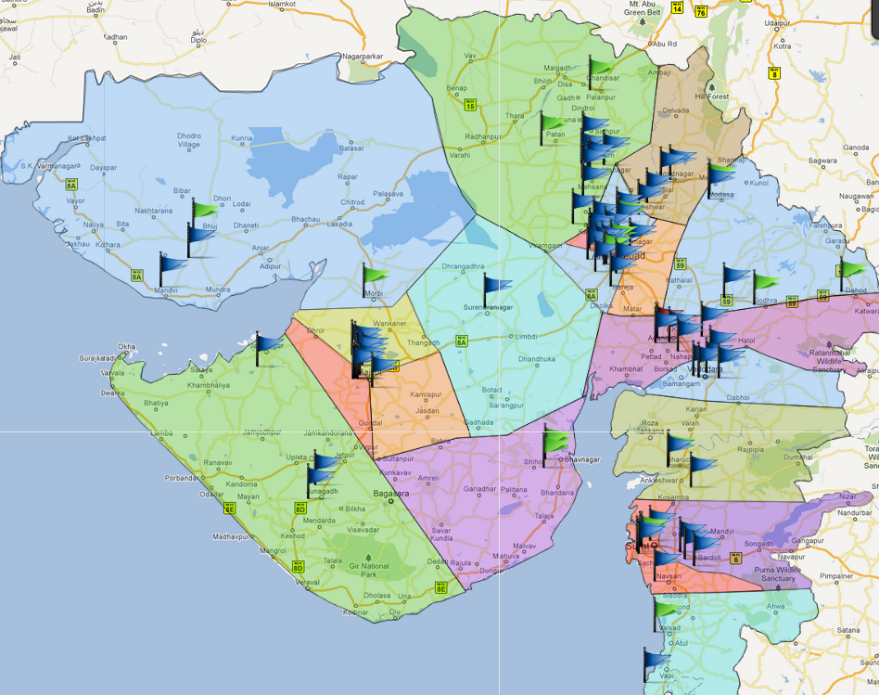
Discrete social innovations
Innovation Networking/Mindset
Innovation Districts/Clusters/ Sankuls
Mining the young technology minds for developing not only discrete
socially viable Innovations but also a culture of “Samvedana” /Compassion
Driven innovation pedagogy.

Slide 44
Engineering Studies: FINAL YEAR PROJECTS at GTU
THE PROTOCOL:
a self declaration form - countersigned by either industry for IDPs or faculty guide for UDPs stating that:
The team has followed ethically practices;
The project is not plagiarised but is original work. (GTU has received 30000 such declaration forms during 12-13.)
2) Intensive Exams: Two external examiners plus internal guide plus industry mentor: 30 students a day; Comments from each examiner required for each project; Supervision by Deans and sankul teams
3) All projects to be posted on GTU web-site
4) Awards to Colleges, which do max original work

Slide 45
Results
17,000 Final Year projects: evaluated in May-June 2012 ---- 73% based on industry problems
1,900 industries have derived benefits from the work, that the students have done
NASSCOM Dewang Mehta awards: All three awards of Rs 1 lakh each won by GTU students
Patents: being filed by students, professors, Colleges and SMEs: Reported –177 patents; expected to reach 200 in a few weeks
137 groups have registered with the Student Start-up Support System (S4) of GTU
ASSOCHAM National Excellence Award 2013 for Best Government University for Promoting Industry-Academic Interface, delivered by Dr. M.M.Pallam Raju, the Union HRD Minister

Slide 46
IPR
Academic Year 2011-12: 2-day Workshops on Patenting in Engineering and Pharmacy: started on Sept 3, 2011
On completion of the projects in 2011-12: Centralized Workshops on Drafting and Filing Provisional Applications: started on 29th April 2012
Academic Year 2012-13: 1-day Workshops on Patent Search
Study of Patents in the area in which the Final Year project is planned - knowledge mining
Student Start-up Support System (S4)
IT Infrastructure Abhiyan

Slide 47
Initiating IPR activities: 3rd September 2011
2-days workshop on “Patenting in Pharmaceutical Sciences”: 140 Faculty members
Five 2-days workshops on “Patenting in Engineering”: 840 Faculty members
2-days Advanced workshop on “Patent Search & Drafting of Provisional Application”: 124 Faculty members
1-day workshop on “Filing of Provisional Patent Application”: 25 Faculty members
Eight 1-day workshops on “Patent Search Methodology”: 1,405 Faculty members

Slide 48
Student Awareness Workshops & Patent Applications
Total no. of Awareness workshop conducted for students……………………………..10
Approximate no. of students, trained in the workshops …………3000
No. of Patents & Copyright Applications filed by GTU faculty, students and colleges… now at 177
Pending Issues: Formation of an IPR Cell at the University and developing an IPR Policy

Slide 49
Millennium Goals: Research Boards
working together
The Board for Rurban Technologies, consisting of GTU Institutions in rural areas and mofussil towns –Vishwakarma Yojana: A Pilot project in 75 villages
A Joint multi-disciplinary project
Board and Center for Environmental and Green technologies to study the areas of Recycling and Re-use of treated Sewage, Urban Air Pollution, Renewable Energy Technologies, Cleaner Production towards Sustainable Development etc
The Board and Center for Mobile Computing and Wireless Technologies
GTU-RCSC (Research & Consultancy Services Cell)
Post-Graduate Research Centers

Slide 50
New Post-Graduate Research Centers
Centers for studies in the areas of
1. Business Ethics and CSR 2. Financial Services
3. Governance Systems in businesses, industries, universities, hospitals, mass transportation systems, NGOs and governments
4. Global Business Studies 5. Marketing Excellence
Center for Technology Education, Public Policy and Universities of the 21st century
Centers for studies in the areas of 1. Cyber Security
2.Environment & Energy Efficiency Tools (CE3T)
3. Infrastructure, transportation and water management (CITWM)
4. Pharmaceutical Studies & Drug Delivery Technologies

Slide 51
Sectoral Innovation Councils
Bring together
Researchers and Developers,
Faculty members from all over Gujarat,
Professionals from the industry – associated with IDPs, and
Mentors from the entire world
to work jointly
to successfully develop innovative products and processes – (for the Final Year Projects) and
to identify new but relevant research problems for post-graduate students.

Slide 52
Post-graduate Teaching
ME Dissertation Review: A unique step to improve the quality of thesis;
Adjunct Professors and 112 (Virtual) Co-Supervisors
Practice-oriented ME programs:
VLSI Design and Embedded Systems
Mobile Computing and Wireless Technologies
Cyber Security
Successful Collaboration with partners from outside the University

Slide 53
Objective: In 5 years, GTU’s theses must be world-class.
At Master’s thesis, three centralized open presentations are required:
Dissertation Phase I: For reviewing Literature survey
Research Week
Defense
Literature Survey presentation of 2012: Observation by one professor from an IIT and another professor from NIT: “Literature survey of most of the students was becoming comprehensive, as compared to the situation in the first year.”
Research Week of 2013: Dr Arun Somani, a professor from Iowa State University, USA reviewed 27 thesis at GTU. He said that ‘at least 50% of these thesis were of American standard’.

Slide 54
Objective: Leadership in Learning Outcomes
Continuously up-dated curriculum in all the fields –with strong inputs from industries:
Created or updated new syllabi for 1200 courses during the last few months. -- STARTED WORKING TOGETHER
World Education Award 2013 for GTU’s project on Active Learning & Creating Excitement in Classes, Labs and Workshops
Introduction of Choice Based Credit System (CBCS) – which makes it possible for a student to apply for credit for work done at other Universities → Flexibility, as required by professionals in business/ industries
INVITATION – to those with an interest in rigorous scientific work- Come & work at GTU for Master’s and Doctoral work.

Slide 55
Swami Vivekanand FDP Contributor Personality Developement
implemented in 2012
from January 2012 – Dec 2012: 750 teachers trained
110,000 students have gone thorugh the course in one year
Gautam Adani: donated Rs 1.15 crores for the program
An Example of Collaboration

Slide 56
Three Skills Councils
GTU Council for Financial Services with 12 Sectoral Panels
GTU Council for Marketing with 7 Sectoral Panels
GTU Council for HR & Organizational Structures with 8 Sectoral Panels
Each Sectoral Panel is co-chaired by a Director of an MBA College and a leading industry professional.
A Secoral Panel: works
to define the skills and certifications required by a professional in its area of interest;
to help GTU develop a close and continuing inter-action with professionals;
to help students of Business Studies in obtaining placements for immersion studies.

Slide 57
Awards during 2013
CMAI’s ICT World Communication Award 2013 for being Pioneer in ICT Education; the Award presented by Kapil Sibal, the Union Minister for Communication & IT, Dr. S.S. Mantha, Chairman AICTE, Hamadoun Toure, General General ITU
World Education Award 2013 for GTU’s project on Active Learning
ASSOCHAM National Excellence Award 2013 for Best Government University for Promoting Industry-Academic Interface, delivered by Dr. M.M.Pallam Raju, the Union HRD Minister
DNA & Star Group Award for the Best Education in Business Studies 2013
AIMS International Innovative University Award 2013 at IIM Bangalore

Slide 58
Structure Reference: Alfred D. Chandler, Introduction-Strategy and structure, MIT Press, 1962 Brought to the Core Committee by: Professor Satinder Kumar
Growth through geographical dispersion brings the need for a departmental structure and headquarters to administer several local field units.
When expansion is aimed at through addition of new types of function, we require a Central Office and a multi departmental structure.
The growth which is attained through new lines of products or through continued growth on a national or international scale requires a multidivisional structure with a general office to administer the different divisions.
An organization, which has experienced growth through expansion, needs to add an administrative office to handle one function in every local area.

Slide 59
Other Issues
Strengthening VC’s Office
2-year deputation of 3 Associate Professors
Staff to run the office full time
Structure with
No more than 5 direct reports
Preferable: 2 levels but no more than three levels for a decision (Sh Ashok Malik)

Slide 60
We can do it!
“Feel the difference” initiatives for teachers, students and others at GTU
Plans for Inter constituent collaboration – for example between MBA and Engineering students
Plans for Inter constituent competition
Plans for Rating of constituents and SWOT analysis
Preparation of a Matrix of Faculty Skills
List of University Degrees, professional accreditations, certifications, number of graduates supervised
Preparation of a Matrix of constituents infrastructure
List of laboratories, facilities, buildings, number of students, Programs, Degrees offered

Slide 61
Questions and Suggestions
Thank you

Slide 62
Joint Research
GTU’s joint research project on Kotler’s Incubator on Ayurvedic medicines:
involves 45 faculty members and students at GTU
mentored by the Kellogg Business School.
16th August 2012 : GTU has joined on two research projects, for which the Chief Investigators are Professors Dr. Friedrich Augenstein and Dr. Ramesh Shah from DHBW. The two projects-
developed in Germany
But of equal interest to India.
Soon researchers from GTU will start working on the projects

Slide 63
Joint Research between
GTU and DHBW Stuttgart
AUGUST 2012
Prof. Dr. Friedrich Augenstein
Dr. Ramesh Shah

Slide 64
Project 1: Survey on Cooperation Management
Initial Situation: Cooperations between companies have failed many times in the past – on a national as well as on an international basis.
To get some deeper insight in today’s cooperation management the DHBW Stuttgart and the “Bundesverband Deutscher Unternehmensberater (BDU)” (German Association of Management Consultants) conducted an online survey on cooperation management in Germany (Chief Investigator: Prof. Dr. Friedrich Augenstein, DHBW Stuttgart).
The survey covers the objectives and areas of cooperations, risks and reasons for failure and success in cooperations, and organizational structures of cooperations.
About 150 German companies took part in the online survey. Some first interesting results have been found.
The results should be compared to a similar survey in an “emerging market”. Because of the close economic relationship between India and Germany the corresponding survey should take place in India.

Slide 65
Project 1: Survey on Cooperation Management (cont.)
Objectives
Ensure, that at least approx.100 companies in India (focus on Gujarat) take part in the survey.
Evaluate the feedback of the survey in India and compare it with the results of the German survey.
Gain valuable know-how on common and different values, perceptions and approaches in cooperation management for companies doing business in India and Germany.
Approach / Next Steps
Translate questionnaire into English language. (DHBW)
Set-up (online) questionnaire and send it (or a link to it) to Indian companies. (GTU)
Evaluate feedback and compare it with results of German survey. (GTU/DHBW)
Develop joint research report. (GTU/DHBW)
Agree on sponsoring of designing, printing and publishing the report. (GTU/DHBW/BDU)
Intended deadline for publishing: January 2013

Slide 66
Project 2: Indo-German Business Activities – DOs and DON’Ts Topic of Study Tour of DHBW students in early 2013
Initial Situation: Many Indian companies face problems in doing business in Germany as well as German companies face problems doing business in India.
Big firms had faced a lot of challenges in this issue and dealt with them partly scientifically, but small to medium-size companies also being able to do business on an international basis lack structured approaches to handle them.
Objectives
Identify most common pitfalls in market entry approaches of Indian firms in Germany and German firms in India.
Structure these pitfalls according to topics like culture, know-how deficits, financing, consumer behavior, legal restrictions, …
Develop success criteria for market entry approaches.
Develop guidelines for successful market entry approaches in India and Germany.

Slide 67
Project 2: Indo-German Business Activities – DOs and DON’Ts
Approach / Next Steps
Pre-studies and surveys on pitfalls (01/13)
Pre-structuring of topics, formulation of survey hypothesis (01/13)
Study Tour of 10 to 15 DHBW students to India (GTU / Parul Institutes) (02/13)
Joint research
Work on literature and information available on internet
Conduct interviews with Indian companies and German companies in India
Study Indian culture, society, regulations etc.
Every student prepares a 10 to 12 pages report on the particular topic she/he has been working on (03/13)
Joint examination of reports by faculty members of GTU/Parul and DHBW (04/13)
Publication of final joint research report (including all single reports) (05/13)
Proposal Joint Research GTU-DHBW Stuttgart August 2012 - Prof. Dr. Friedrich Augenstein
67
Notes:
67

Slide 68
The treasures of today’s world

Slide 69
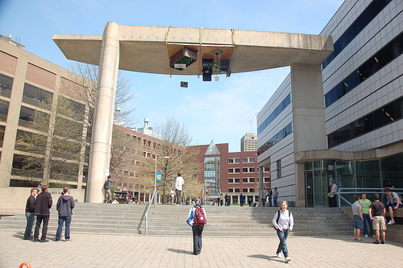
MIT, Cambridge

Slide 70
MIT, Cambridge
Charles river

Slide 71
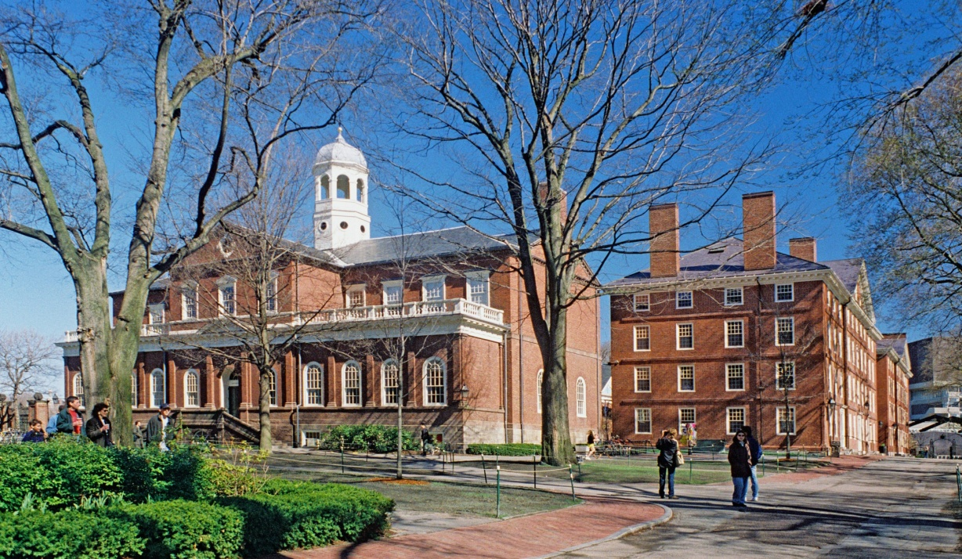
Harvard University, Boston

Slide 72
Harvard University, Boston
Charles river

Slide 73
UC Berkeley

Slide 74
UC Berkeley

Slide 75
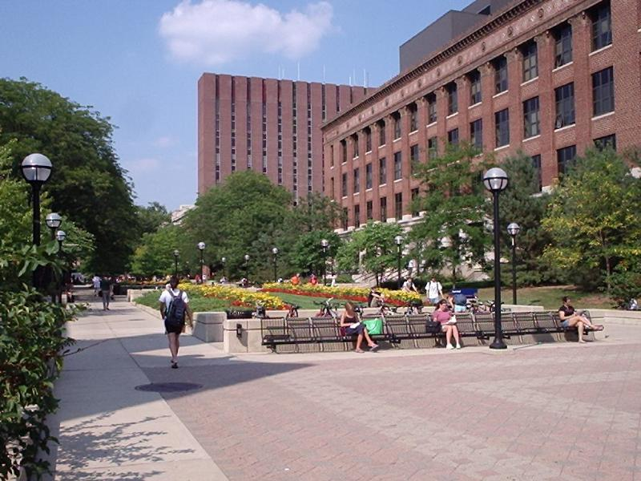
University of Michigan, Ann Arbor

Slide 76
University of Michigan, Ann Arbor
Huron River

Slide 77
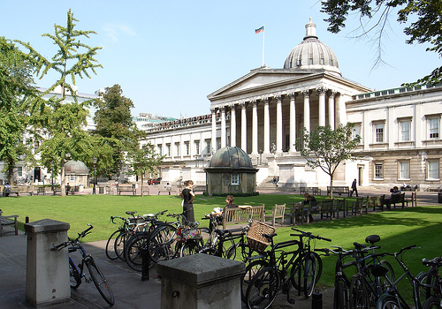
University College, London

Slide 78
University College, London
Thames river

Slide 79
